Slide 1
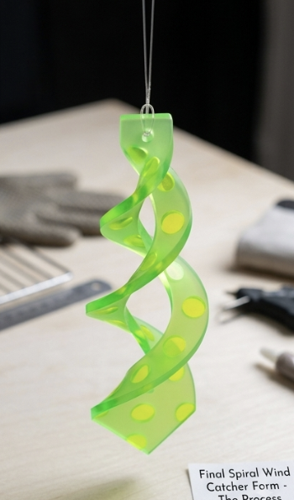

IGCSE Design Technology
Wind Catchers - Product Evaluation
Rate your own product and collect two opinions form peers. Record the evaluation on a google slide. Present your final product.
It must have surface detail that follows a theme
It must have at least one shape modification
It must not have any sharp corners
It must have a high quality finish.
On a scale of 1-5, rate the criteria below to evaluate your product. Photograph the product in use. Present Evaluation on ONE page
DESIGN
Criteria / Design | TOTAL average score | Material | Processes | Surface Details / Aesthetics | Form / Shape | Safety / Quality outcome | Wind Spinnable Function | opinion overall score (creativity,originality, aesthetics)
Opinion 1 | 16 | Acrylic (PMMA) Recycling Code 7 | Shaping, masking, sand-blasting, thermo-forming | 3 | 3 | 4 | 3 | 3
Opinion 2 | 16 |  |  | 3 | 3 | 3 | 4 | 3
Own Opinion | 18 |  |  | 3 | 4 | 4 | 4 | 3
Future Improvements / Changes | Make the shape of it look more unique instead of just rounding corners and also use better textures for sand blasting

